Slide 1
Computer Architecture
Lecturer-in-charge: K.P.N Jayasena

Slide 2
Objectives
At the end of this lecture you will be able to explain
The basic structure of a computer and its main components
Elements of CPU
Bus architecture
How CPU and its components work

Slide 3
Agenda
Von Neumann Architecture.
The main components of a computer.
Bus Architecture.
CPU, its elements and functioning.
Fetch-Execute Cycle
Notes:
3

Slide 4
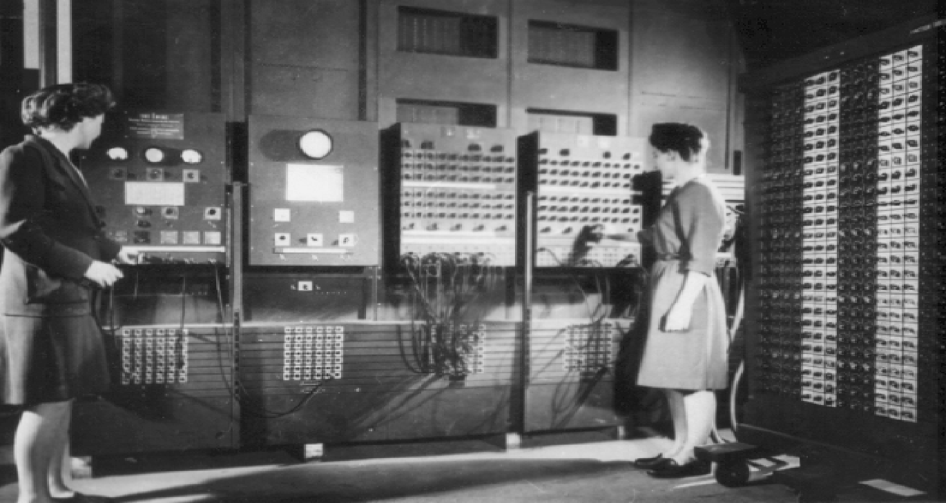
Hard Wired Programming
Early computers were programmed, using large number of switches in the console panel and plugging/unplugging cables
It is called hardwired programming
Notes:
ENIAC ( Electronic Numerical Integrator And Computer)^{[1][2]} was the first general-purpose electronic computer)
4

Slide 5
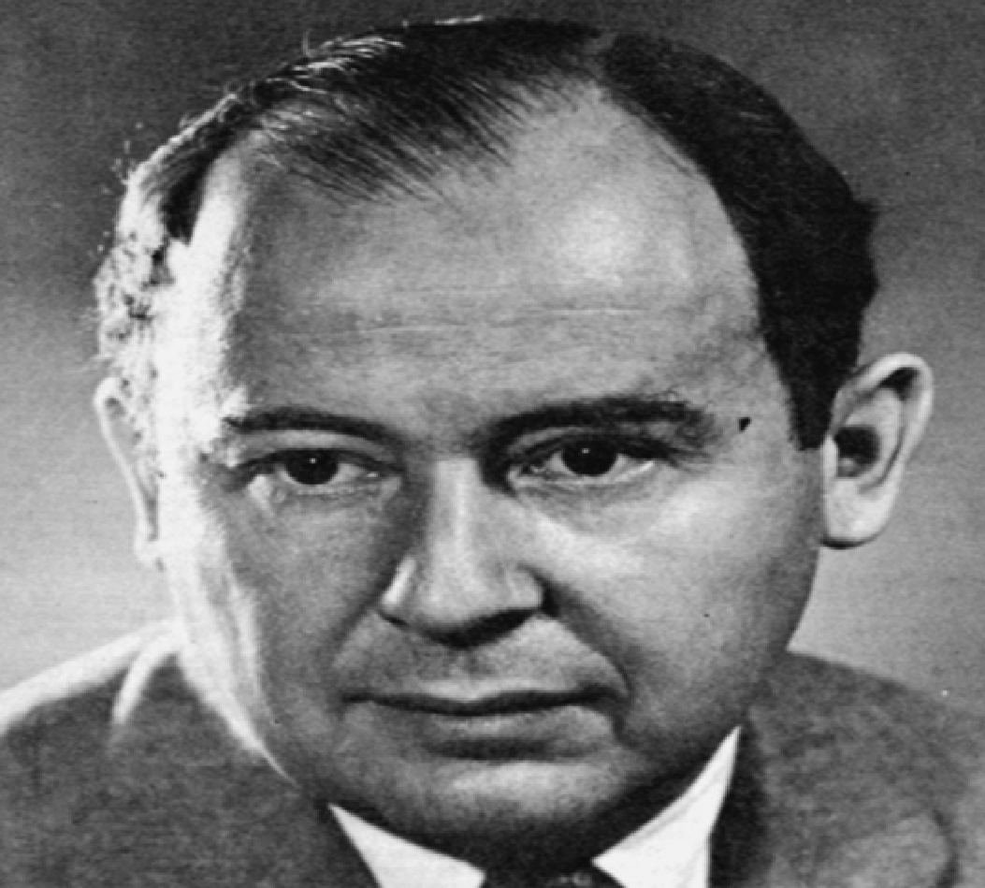
John Von Neumann
It was required re-wire and re-design the machine to run a
different programs. It was a manual and very tedious task
Von Neumann proposed that programs and data can be stored in a memory device and instead of rewiring the machine we can change the program easily. (Stored Program Concept)
Notes:
5

Slide 6
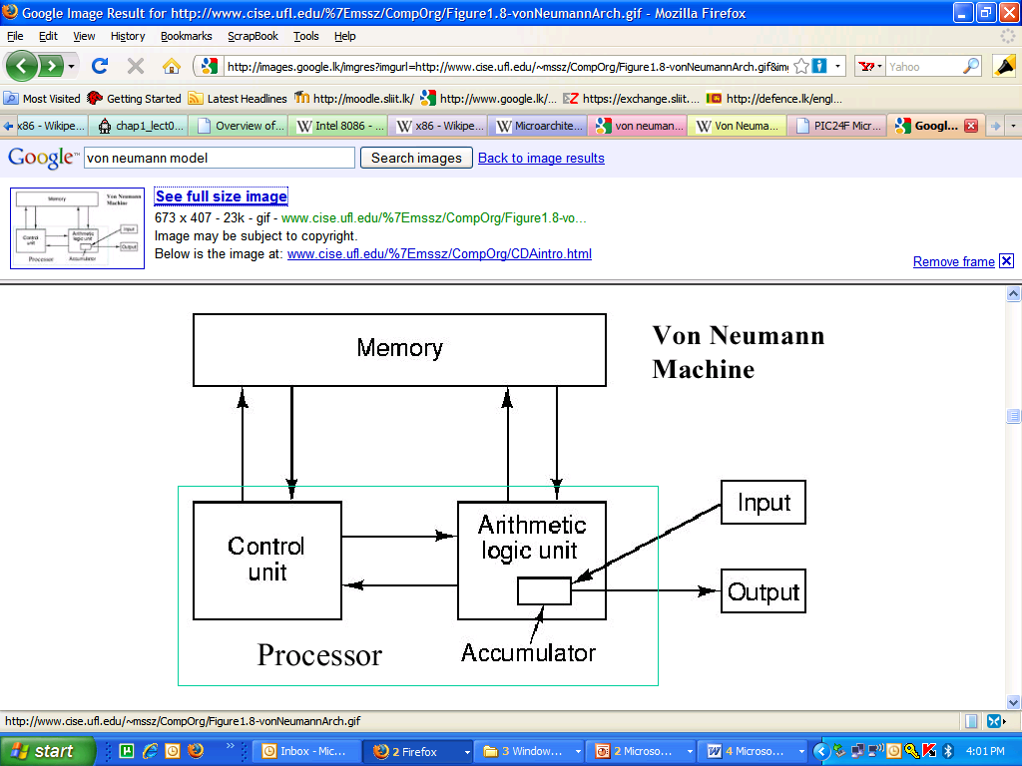
Von Neumann Architecture
Important Components
Notes:
6
von Neumann Architecture. John von Neumann elucidated the first practical stored-program computer architecture (scheme for connecting computer components) in the mid-1940s. It is comprised of the five classical components (input, output, processor, memory, and datapath). The processor is divided into an arithmetic logic unit (ALU) and control unit, a method of organization that persists to the present. Within the processor, the ALU datapath mediates data transfer for computation. The registers are fast memory modules from/to which data can be read/written to support streaming computation, as shown in Figure 1.8. Within the ALU, an accumulator supports efficient addition or incrementation of values corresponding to variables such as loop indices.

Slide 7
Von Neumann Architecture
The use of the binary number system
A single sequentially addressed memory
A separate arithmetic/logic unit for performing arithmetic and logical computations
The stored program concept in which both the programs and its data are stored in memory.
A controller that fetches instructions from memory and executes them.

Slide 8
Main Components of a Computer
CPU
Main Memory
I/O Modules
Interconnections (buses)
Notes:
8

Slide 9
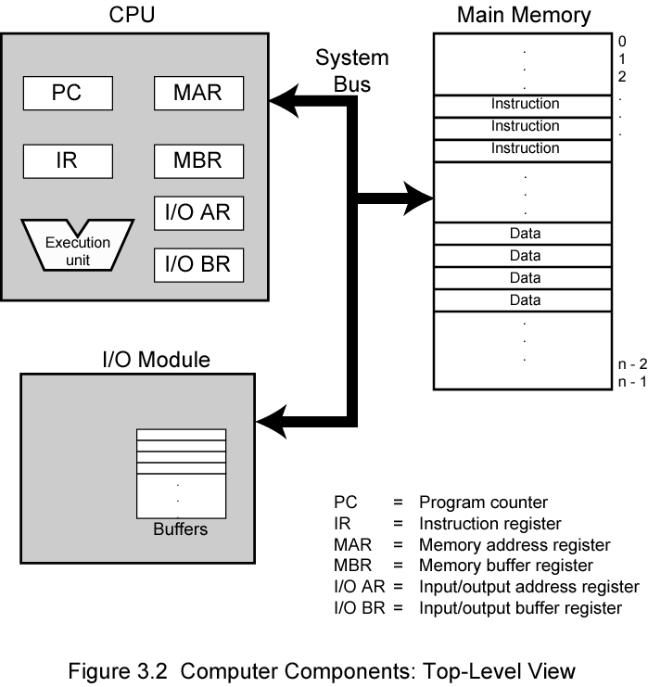
Main Components of a Computer
Notes:
9

Slide 10
CPU
CPU is like the brain of the computer.
Main functions:
Fetch data and instructions from memory.
Coordinate the complete execution of each instruction.
Main Components of the CPU
ALU (Arithmetic and Logic Unit).
Control Unit.
Registers.
Notes:
10

Slide 11
Memory
The memory is a collection of storage cells, each of which can be in one of the two states.
One state represents a value “0” and the other represents a value of “1”.
By distinguishing these two different logical states, each cell is capable of storing a single binary digit, or bit, of information.

Slide 12
Primary Memory
Primary storage or memory: Is where the data and program that are currently in operation or being accessed are stored during use.
Consists of electronic circuits: Extremely fast and expensive.
Two types:
RAM (non-permanent)
Programs and data can be stored here for the computer’s use.
Volatile: All information will be lost once the computer shuts down.
ROM (permanent)
Contents do not change.

Slide 13
Input output modules
Input output modules interface the Computer system to the input output devices.
Video controller
SCSI disk controller
These modules enable program and data to be entered to the system.
In CPU’s perspective there is no difference between the way of accessing the memory and the input out modules.

Slide 14
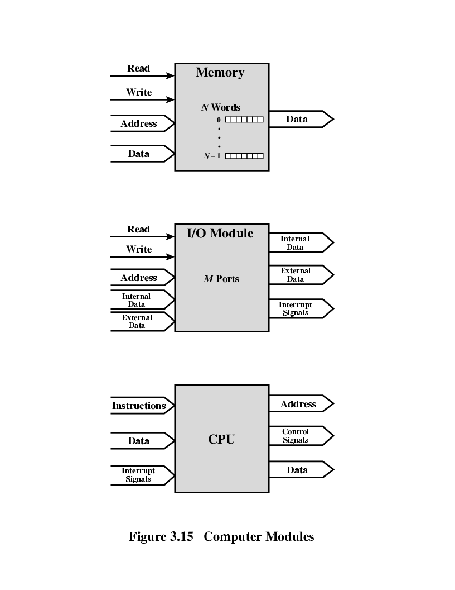
I/O Module Connections
Similar to memory from computer’s viewpoint
Output
Receive data from computer
Send data to peripheral
Input
Receive data from peripheral
Send data to computer
Notes:
14

Slide 15
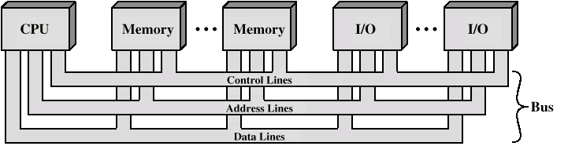
Buses
A communication pathway connecting two or more devices
Often grouped
A number of channels in one bus
e.g. 32 bit data bus is 32 separate single bit channels
Buses carry data, instructions and control signals.
Notes:
15

Slide 16
Structure of the CPU
CPU
Computer
Arithmetic
and
Login Unit
I/O
Registers
System
Bus
CPU
Internal CPU
Interconnection
Memory
Control
Unit
Notes:
16

Slide 17
ALU
Combines and transforms the data using
Arithmetic operations (+, -, /, *)
Logical operations (bit-wise negation, AND , OR)
The results of an arithmetic-logic unit operation are usually transferred to the accumulator.
Lecture 07 – Computer Organization – Part I

Slide 18
Accumulator
A register located on the central processing unit.
The contents can be used by the ALU for arithmetic and logic operations, and by the memory buffer register.
Usually, all results generated by the arithmetic-logic unit end up in the accumulator.

Slide 19
Accumulator
Example: Say ALU would perform NOT operation on data in its accumulator as shown below.
Accumulator before ALU perform the NOT operation
1 | 0 | 1 | 1 | 1 | 1 | 0 | 0
Accumulator After ALU perform the NOT operation
0 | 1 | 0 | 0 | 0 | 0 | 1 | 1
Lecture 07 – Computer Organization – Part I

Slide 20
Control Unit
Control unit is the nerve center of the computer. (brain with in the brain)
It coordinates and controls all the hardware operations.
(i.e. that is all the peripheral units and the CPU itself).
Control units fetches instructions from the memory, decodes it and gives control signals according to the instruction.

Slide 21
Registers
A register is a discrete, high speed memory location within the CPU designed to hold temporary data, instructions or results.
A modern CPU will hold a number of registers.
1 . General purpose registers.
Ex: AH,AL,BH,BL
2. Special purpose registers
Ex: Control registers, flag registers

Slide 22
Control Registers of the CPU
Programme Counter(PC)
Contains the address of the next instruction to be fetched
Instruction Register(IR)
Instruction most frequently fetched
Memory Address Register(MAR)
Address of a location in memory
Memory Buffer Register(MBR)
Contains a word of data to be written to memory or the word most recently read
Notes:
22

Slide 23
Control Registers : Program Counter Register(PC)
Before the CPU can execute an instruction, the instruction must first be brought to the CPU from the computer‘s memory.
PC register contains the memory address of the next instruction to be executed.
After fetching of an instruction is completed program counter is incremented by one.
[PC] 🡨 [PC] + 1

Slide 24
Control Registers: Memory Access Register(MAR)
Fetching an instruction begins with the program counter being moved to the memory address register (MAR).
[MAR] 🡨 [PC]
This register locates in the CPU and in turn connect to address bus.
Specifies the address in memory where information can be found and can be also used to point to a memory location where information is to be stored.

Slide 25
Control Registers: Memory Data Register(MDR)
A register located on the CPU which is in turn
connected to the data bus of the system.
Also known as Memory Buffer Register (MBR).
The memory location stored in the memory address register is used to copy data from or to the memory buffer register.
Examples …

Slide 26
Control Registers: Instruction Register (IR)
IR is the part of a CPU's control unit that stores the instruction most recently fetched.

Slide 27
Status Registers(Flag Registers)
The status register is a hardware register which contains information about program state.
Takes the snapshot of state of the ALU after each instruction is executed.
The CPU updates the bits of the status register after it carries out arithmetic or logical operation to reflect the nature of the result.
Notes:
27

Slide 28
Status Registers(Flag Registers) cnt...
Bits of the status register could be ,
Sign: sign bit of the result of the last arithmetic operation
Zero: set when the result is zero
Carry: set if an operation resulted in a carry
Equal: set if a logical compare result is equality
Overflow: used to indicate arithmetic overflow

Slide 29
Buses
A communication pathway connecting two or more devices
Often grouped
A number of channels in one bus
e.g. 32 bit data bus is 32 separate single bit channels
Buses carry data, instructions and control signals.
Notes:
29

Slide 30
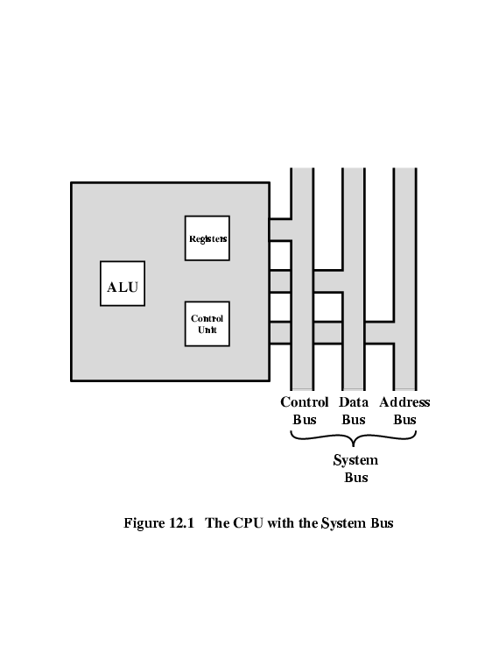
CPU with System Bus
A Bus is a communication pathway two or more devices
Notes:
30

Slide 31
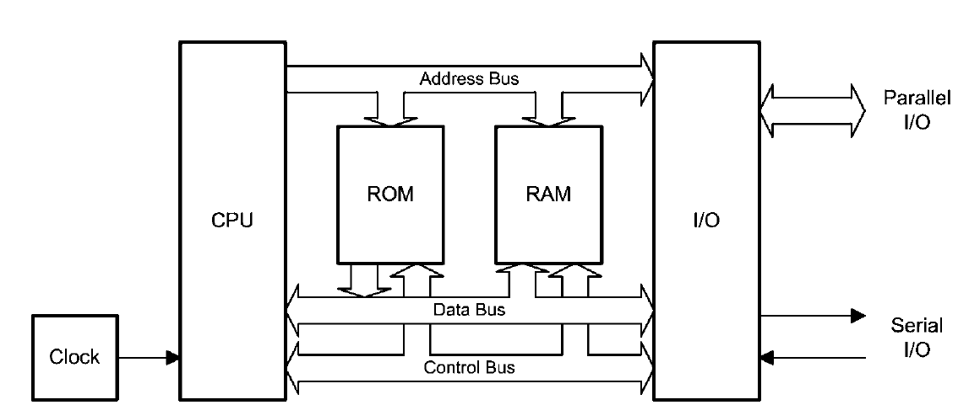
System Bus
What is this ROM(will be discussed later)
Notice the direction of buses.
Notes:
31

Slide 32
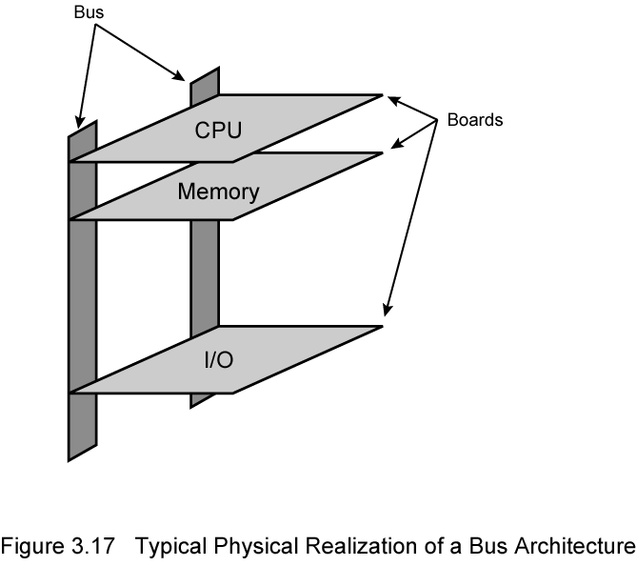
Bus Architecture
Notes:
32

Slide 33
Data Bus
Carries data
Remember that there is no difference between “data” and “instruction” at this level
Width of a bus is a key determinant of performance
8, 16, 32, 64 bit
Bi-directional
Notes:
33

Slide 34
Address Bus
Identify the source or destination of data
e.g. CPU needs to read an instruction (data) from a given location in memory
Bus width determines maximum memory capacity of system
e.g. 8080 has 16 bit address bus giving 64k address space
If the width of the address bus is 32 what is the maximum addressable memory ?
Uni-directional
Notes:
34

Slide 35
Control Bus
It is used to transmit a variety of individual signals (read, write, interrupt, acknowledge) necessary to control and coordinate the operations of the computer.
Control and timing information
Memory read/write signal
Interrupt request
Clock signals
Bi-directional
Notes:
35

Slide 36
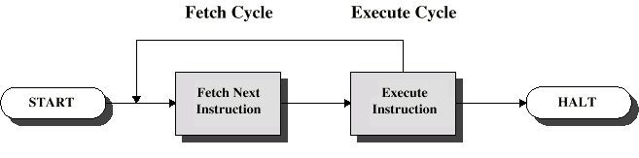
CPU Functions
Fetch instructions
Execute instructions
Interpret instructions
Fetch data
Process data
Write data
Notes:
36

Slide 37
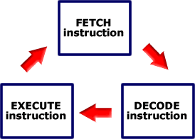
Instruction Cycle
All computers have an instruction cycle.
A basic instruction cycle can be broken down into the following steps:
Fetch cycle - Fetch an instruction
Decoding
Execute cycle - execute an instruction

Slide 38
Fetching Cycle
PC contains address of next instruction
Address moved to MAR
Address placed on address bus
Control unit requests memory read
Result placed on data bus, copied to MBR, then to IR
Meanwhile PC incremented by 1
Notes:
38

Slide 39
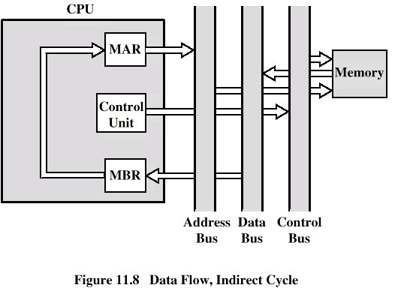
Data Fetch
Notes:
39

Slide 40
Fetch the Instructions
Memory
Control Unit
001
002
Ins-1
PC
003
002
MAR
A107
B5
002
A108
13
MBR
IR
A109
AC
Ins-1
Ins-1

Slide 41
Decoding
After the fetching an instruction, the CU checks the contents of the IR and determines which type of execution is to be carried out next.
This process is known as the decoding phase. The instruction is now ready for the execution cycle.
Decoding the opcode in the instruction register includes following:
Determining the instruction
determining where its operands are in memory
Retrieving the operands from memory
Allocating processor resources to execute the coomand

Slide 42
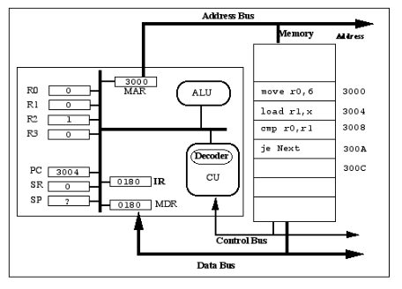
Instruction Formats
0
3
4
15
Opcode
Address of the operand
Notes:
42

Slide 43
Execute Cycle
The actions within the execution cycle can be categorized into the following four types of operations:
CPU - Memory: Data may be transferred from memory to the CPU or from the CPU to memory.
CPU - I/O: Data may be transferred from an I/O module to the CPU or from the CPU to an I/O module.
Data Processing: The CPU may perform some arithmetic or logic operation on data via the arithmetic-logic unit (ALU).
Control: An instruction may specify that the sequence of operation may be altered.

Slide 44
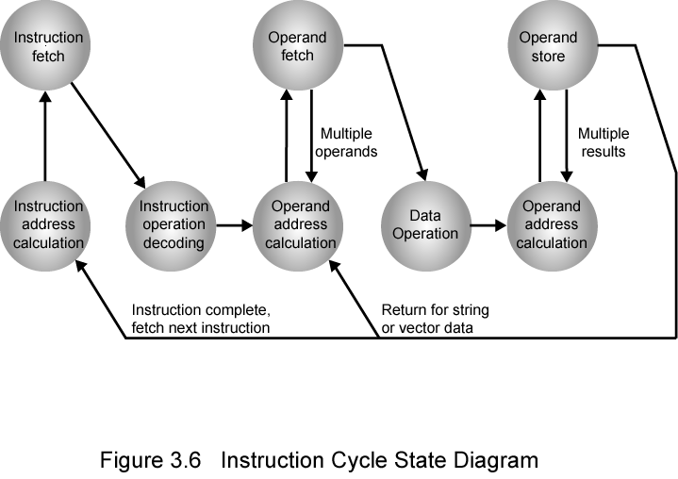
Instruction Cycle State Diagram
Notes:
44

Slide 45
Fetch the Data
(We want to add data stored in location A107 to ACC)
Control Unit
Memory
001
Accumulator
002
Ins-1
100
178
003
MAR
IR
A107
78
78
xxxx|xxxxxxxx
A107
A108
13
MDR
A109
AC
78
Notes:
45

Slide 46
Fetch the Data
(We want to write data stored in Accumulator to A108)
Control Unit
Memory
001
Accumulator
002
Ins-1
100
003
MAR
A107
78
78
xxxx|xxxxxxxx
A108
A108
13
100
MDR
A109
AC
100

Slide 47
Data Fetch
IR is examined(Decoding)
If indirect addressing has been used
Right most N bits of MBR transferred to MAR
Control unit requests memory read
Result (address of operand) moved to MBR
Notes:
47

Slide 48
Registers
A register is a single permanent storage location within the CPU used for a particular purpose.
• Examples of registers:
– Program counter (PC)
– Instruction register (IR)
– Memory address register (MAR)
– Memory data register (MDR)
– Accumulator (ACC)
– Status register
• General purpose registers
– Included on some CPUs
– Used for high-speed temporary storage

Slide 49
Program Counter ( PC )
A dedicated register in the CPU.
Contains the address in memory of the current instruction being executed.
Incremented automatically after each instruction.
Usually initialize to zero when machine starts, or is reset.

Slide 50
Instruction Register ( IR )
A dedicated register in the CPU which contains the actual current instruction
Op Code + Address
What To Do
Location of Data
Simple 16-bit example:
1101 101101100100
Notes:
50

Slide 51
Memory registers
Memory Address Register (MAR)
Contains Address in memory to find or place data.
Memory Data Register (MDR)
Contains Actual Data to be placed in location given in MAR, or which has been retrieved from location given in MAR.

Slide 52
Accumulator
A dedicated register (or set of registers) in the CPU used for the actual manipulation of data.
Default source (or destination) register.
Usually contains results of arithmetic or logical
operations.

Slide 53
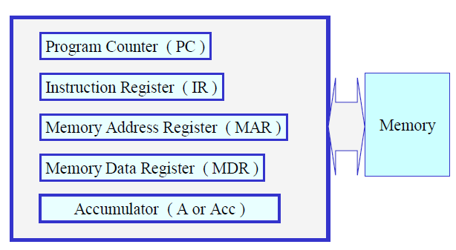
Generic CPU With Registers

Slide 54

Fetch-Execute Cycle
• Two steps, or cycles, in the execution of
every instruction
– Fetch
fetch the code for the instruction from
memory and place it in the IR (instruction
register)
– Execute – execute the instruction

Slide 55
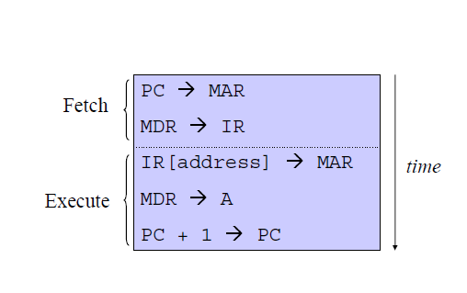
The LOAD Instruction
PC -> MAR
Transfer the address from the PC to the MAR
MDR -> IR
Transfer the instruction to the IR
IR(address) -> MAR
Address portion of the instruction loaded in MAR
MDR -> A
Actual data copied into the accumulator
PC + 1 -> PC
Program Counter incremented

Slide 56
Store Fetch/Execute Cycle
PC -> MAR
Transfer the address from the PC to the MAR
MDR -> IR
Transfer the instruction to the IR
IR(address) -> MAR
Address portion of the instruction loaded in MAR
A -> MDR*
Accumulator copies data into MDR
PC + 1 -> PC
Program Counter incremented

Slide 57
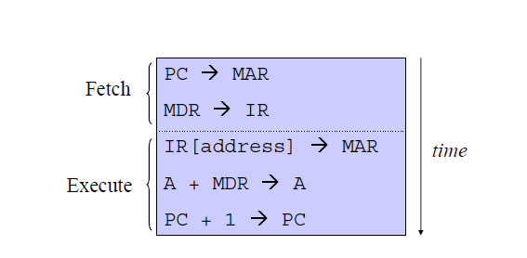
The Add Instruction
PC -> MAR
Transfer the address from the PC to the MAR
MDR -> IR
Transfer the instruction to the IR
IR(address) -> MAR
Address portion of the instruction loaded in MAR
A + MDR -> A
Contents of MDR added to contents of accumulator
PC + 1 -> PC
Program Counter incremented

Slide 58
Fetch-Execute Example: Load Accumulator
Assume: Simple Eight bit system.
Thirty-two memory locations (0 to 31).
“Load” instruction is 010.
Value in location 15 is ten (ie: binary 00001010)
PC is at 5, about to increment.
The instruction, 01001111, is in location 6

Slide 59
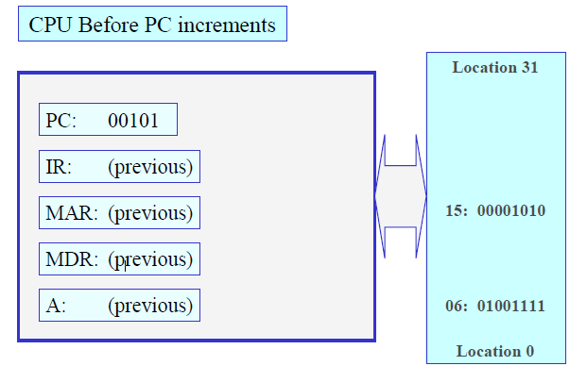

Slide 60
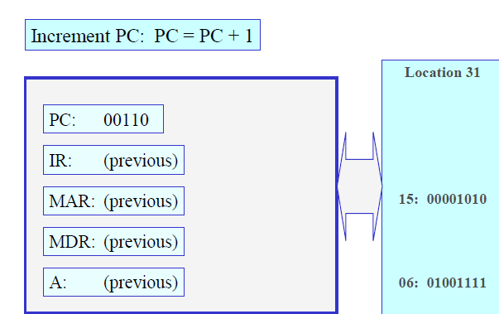

Slide 61
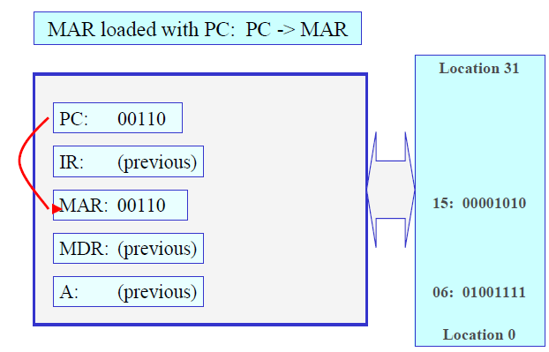

Slide 62
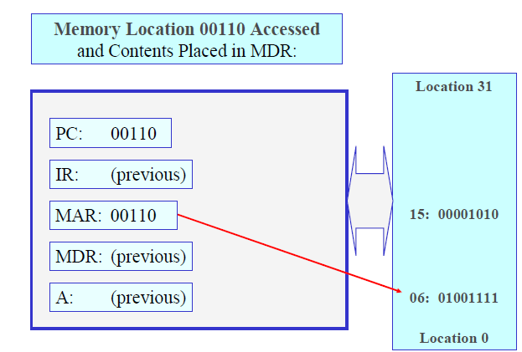

Slide 63
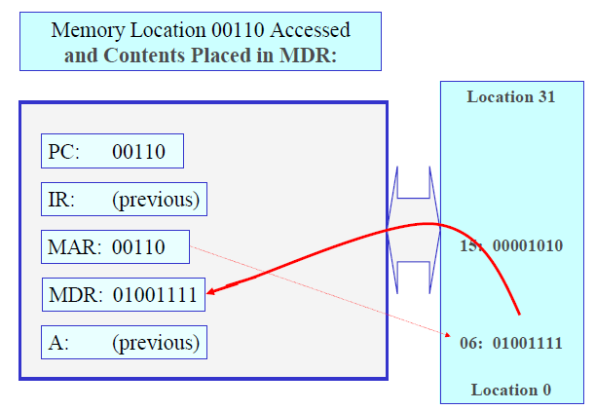

Slide 64
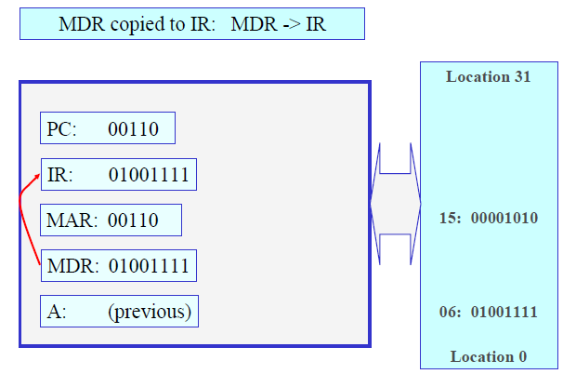

Slide 65
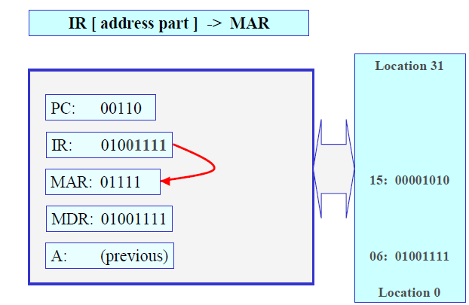

Slide 66
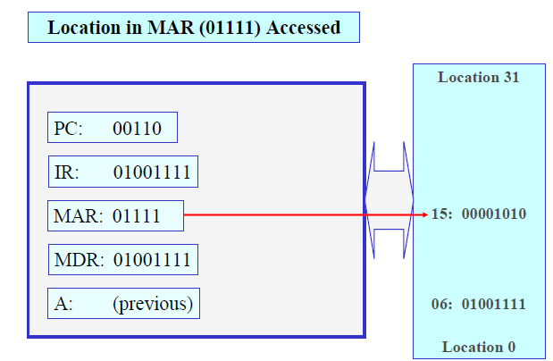

Slide 67
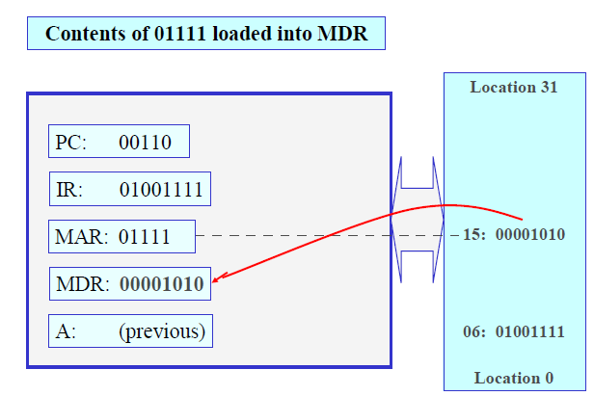

Slide 68
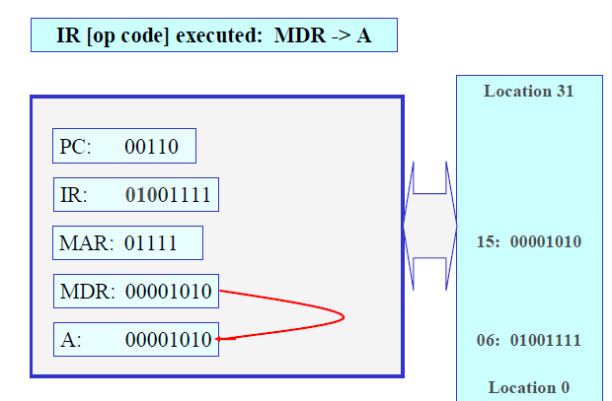

Slide 69
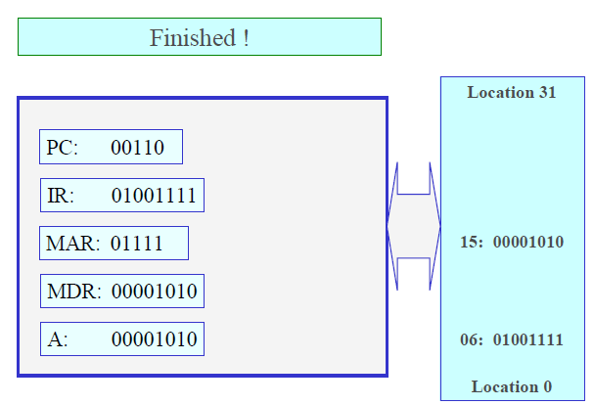

Slide 70
Now:
Assume: Value in location 7 is 10110010.
“ Add” instruction is 101.
Value in location 18 is seventy- one
(i.e.: binary 01000111)

Slide 71
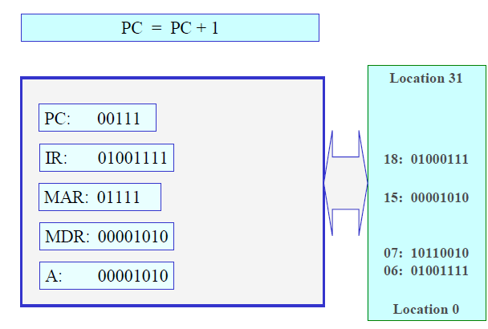

Slide 72
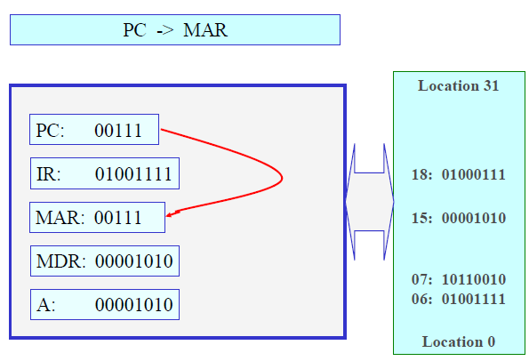

Slide 73
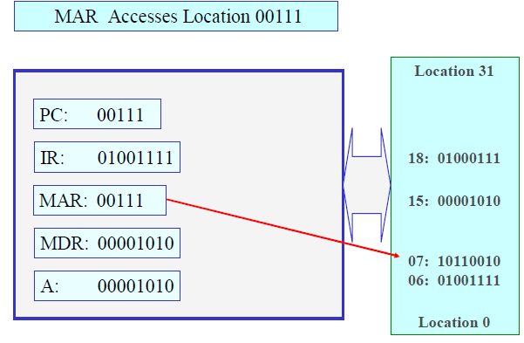

Slide 74
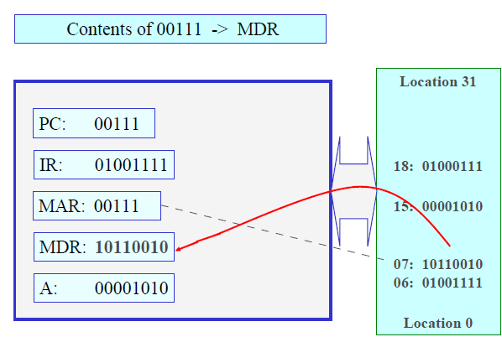

Slide 75
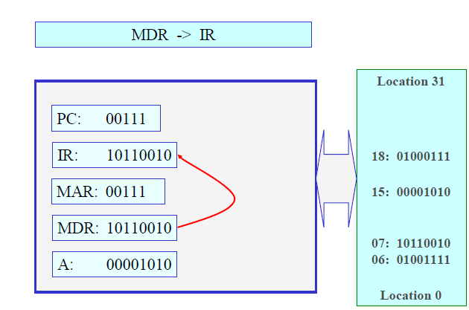

Slide 76
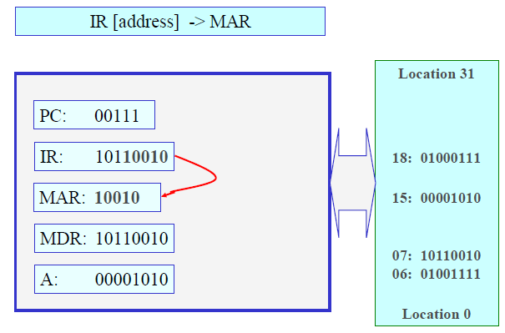

Slide 77
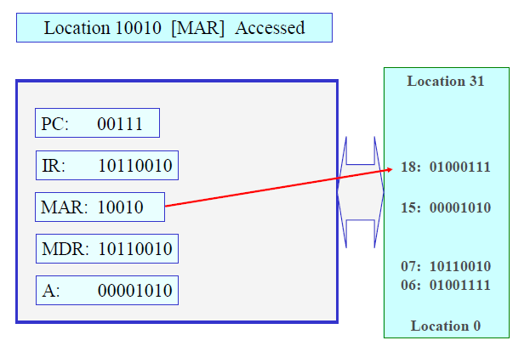

Slide 78
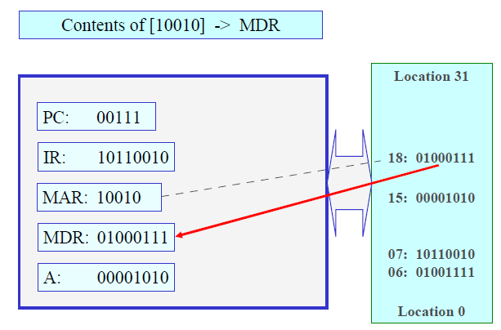

Slide 79
